Slide 1
Project Update and Insights – February 25th Overall Status and Summary
Engagement progressing despite headwinds due to upcoming critical April release.
Engineering
Status: at risk
Focus on April release continues to divert time & attention from AI initiatives despite organic gains with AI assistance.
All engineering actively using AI Copilot for AI-assisted PRs; devs trialling multiple models incl. Gemini 2.5 Pro, Sonnet 4.6
Live dashboards tracking AI-assisted PRs over key repos; early data shows increase in PRs & decreased resolution times
Team is building an MCP server for EasyVista using AI assistance.
Initial Tap campaign showing generally positive NPS & providing meaningful insight into concerns (e.g.
Symphony unable to complete Java modernisation with agentic tooling. Met with 3 alternative vendors to keep momentum.
Sales
Status: on track
Lemlist US pilot live (Feb 20); English BDR training this week, French session pushed to next week (Laure+ Raphael OOO until Mar 2). HubSpot integration confirmed with Alessio
Lemlist Acct Manger assigned and speaks French, Spanish and English. Supporting global kickoffs
Loopio library fully imported and translated 3 days early. First RFP completed end-to-end (Mohawk) -- ~3xfaster. NAM team trained and actively using.
Product
Status: at risk
3 of 5 total phases of work are completed, with remaining phases of (4) TAM calculations and (5) proof points still to do. Expected completion is still within the next four weeks.
Limited access to Loïc due to PTO and other unstated reasons has delayed progress. Project remains achievable by the end of March assuming full engagement after Loïc’s return from PTO.
Highly limited telemetry / adoption signals on key AI features, limiting inputs for TAM calculations.

Slide 2
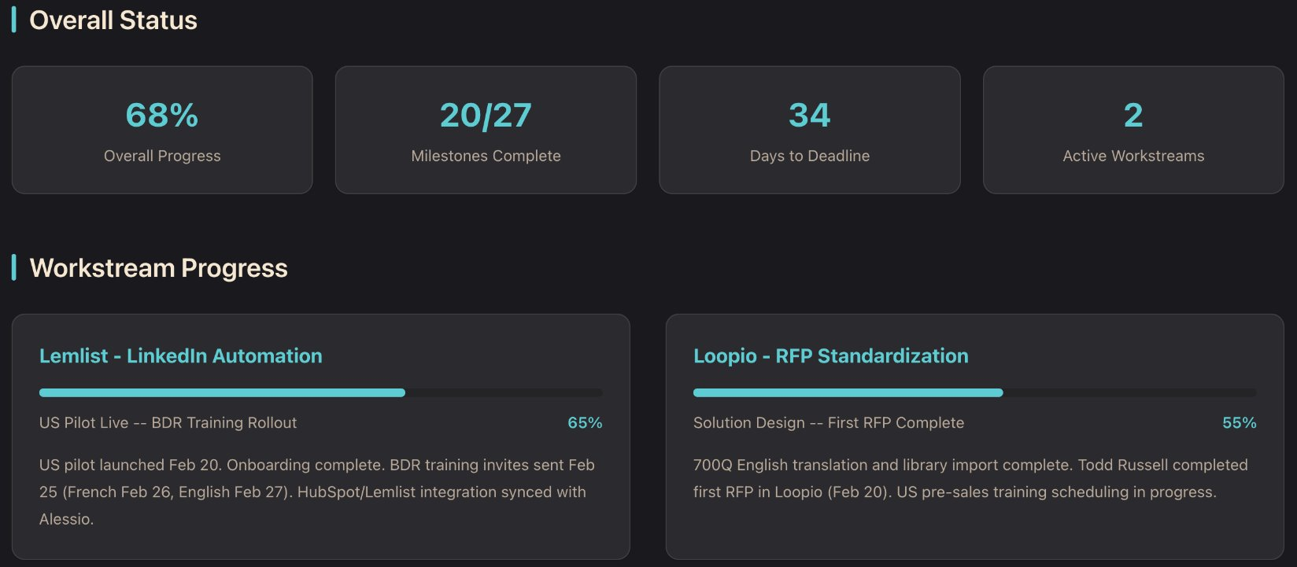
Sales & GTM - Project Update and Insights
"Yes, we are on track. The translation is fully completed and has been imported into Loopio. We've already had two training sessions with Todd, and another one is scheduled for tomorrow. The NAM team has been attending, and they are now much more comfortable and confident with the platform."
- Dalila Souiah | Feb 19th
"Everything was well translated in English and imported in Loopio. Technical and functional content. And the General Information/Security content today. We made several training/explanation session with Todd to explain how use Loopio to answer the first RFP. Feedbacks are good."
Yann Mercier | Feb20th
​"We were able to complete the first RFP with Loopio for Mohawk. While this took a little longer as we were also using it to check translation a bit further, I believe that it will allow us to vastly reduce the time it will take to complete RFPs in the future."​
Todd Russell | Feb 20th
2

Slide 3
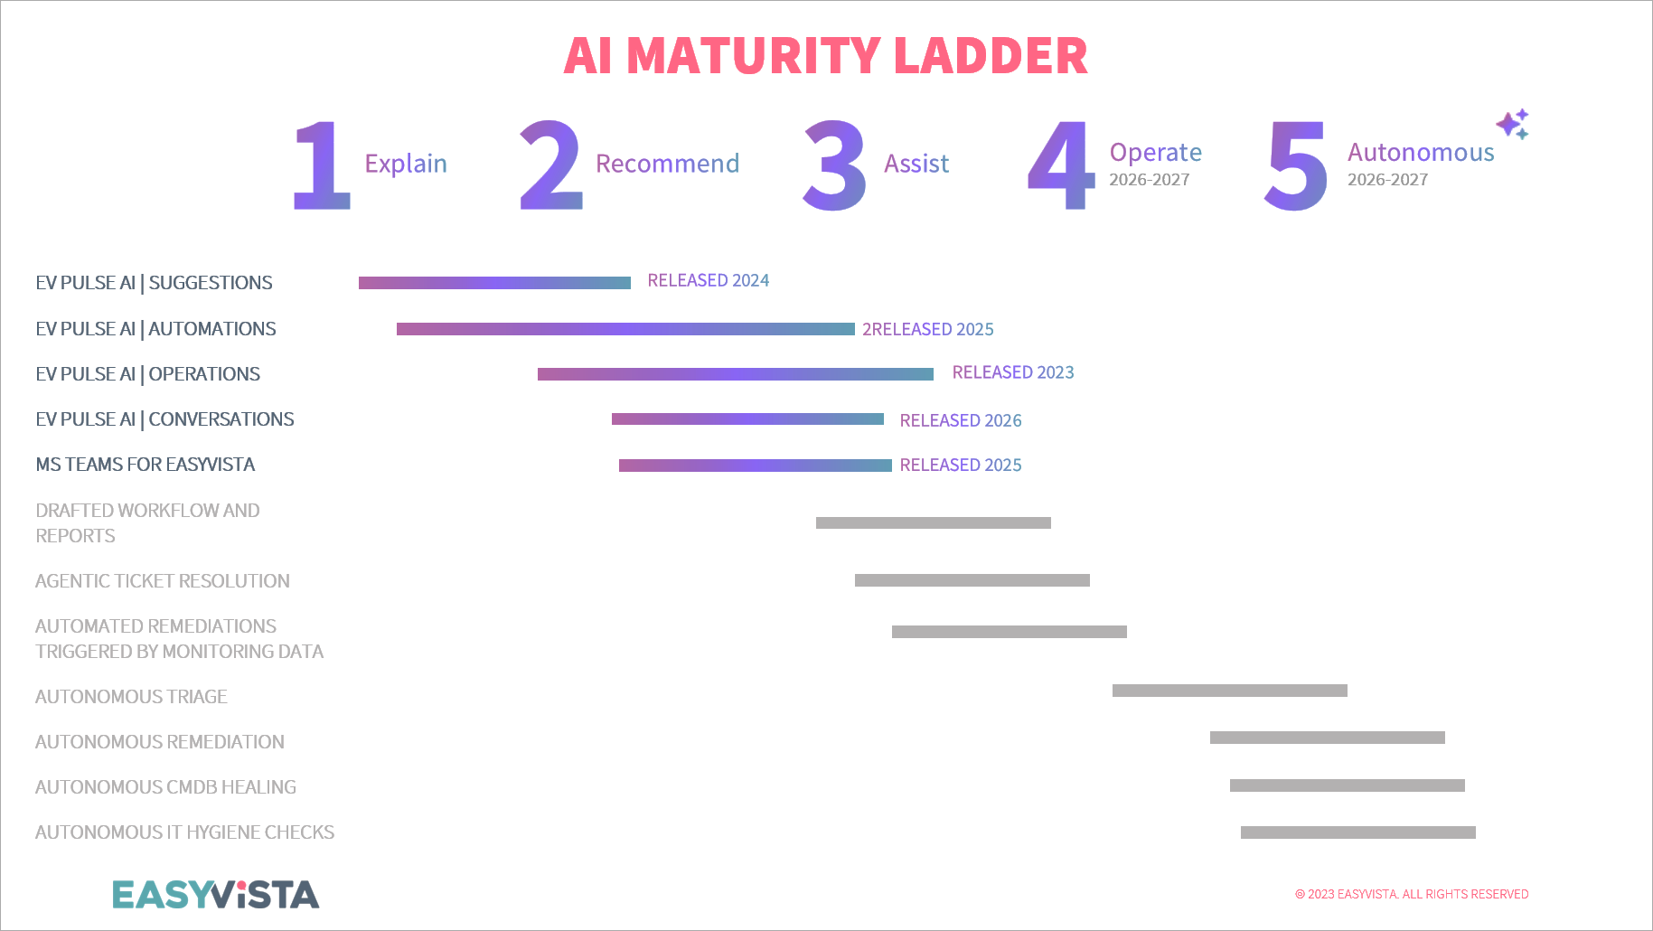
Project Update and Insights – February 25th Product Track: AI Maturity Ladder Completed
Together with Loïc, all levels of the EasyVista AI Maturity ladder have been defined, and all current + planned AI capabilities are mapped to it.
This enables clarity of planning and also displays a clear path towards end-customer labor replacement as platform autonomy grows.

Slide 4
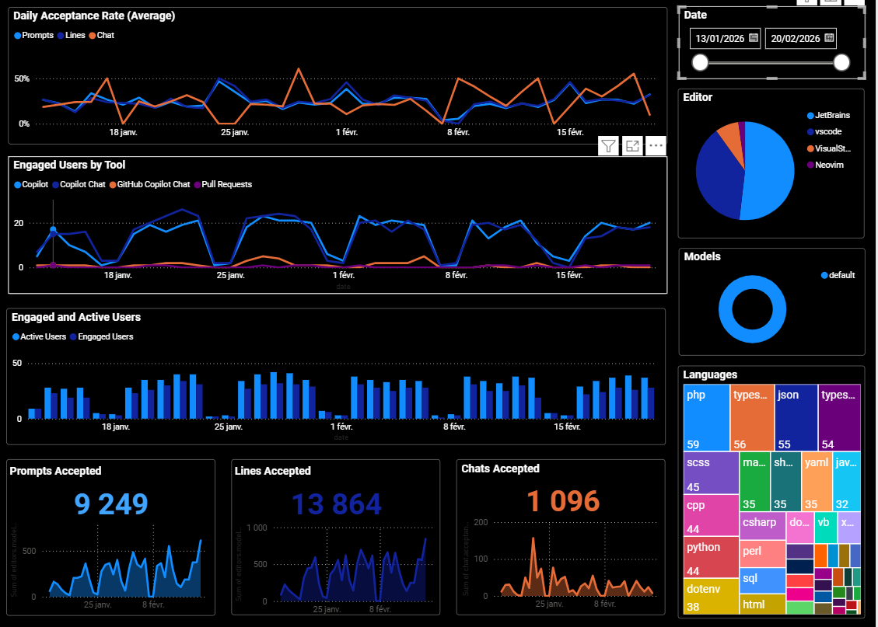
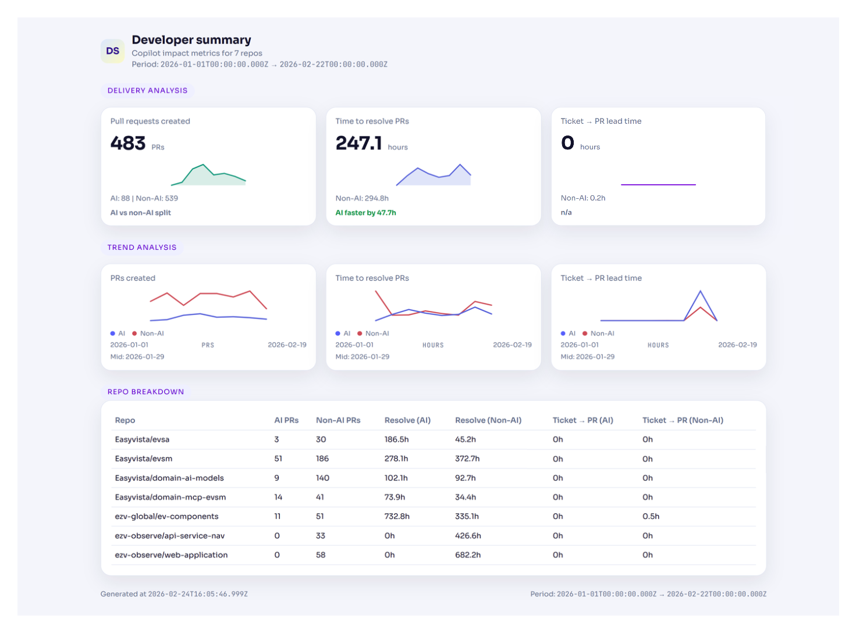
Project Update and Insights - February 25th Engineering Track: Metrics tell a mixed story
Working well:
AI PRs resolve faster (~16% improvement)
DAU ~50-55% is reasonable for time into adoption
Meaningful PR volume with AI @ 18% but room to increase
Gaps for improvement:
Two repos have zero AI PRs
Some AI PR resolve times are worse, not better
Immaterial improvement trend in metrics
Ensuring code quality remains high as volume grows

Slide 5
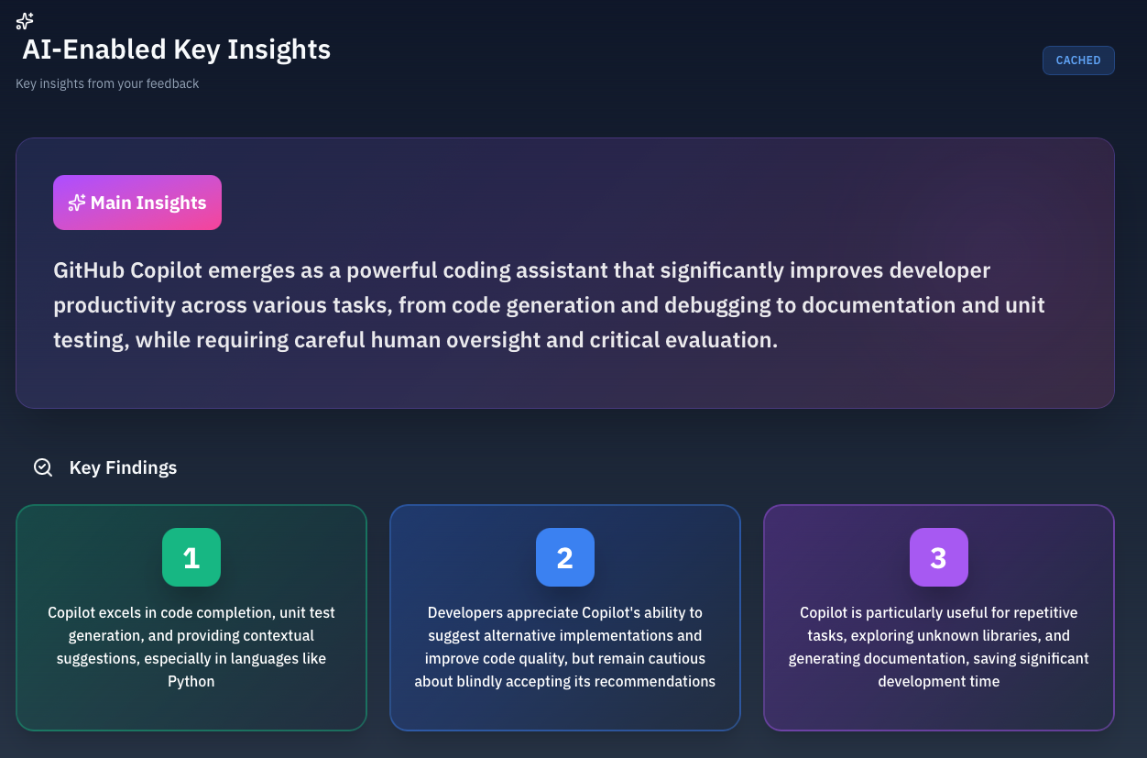
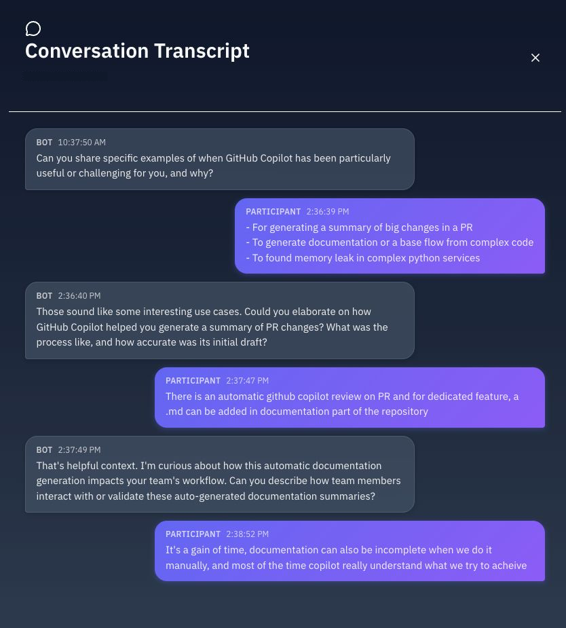
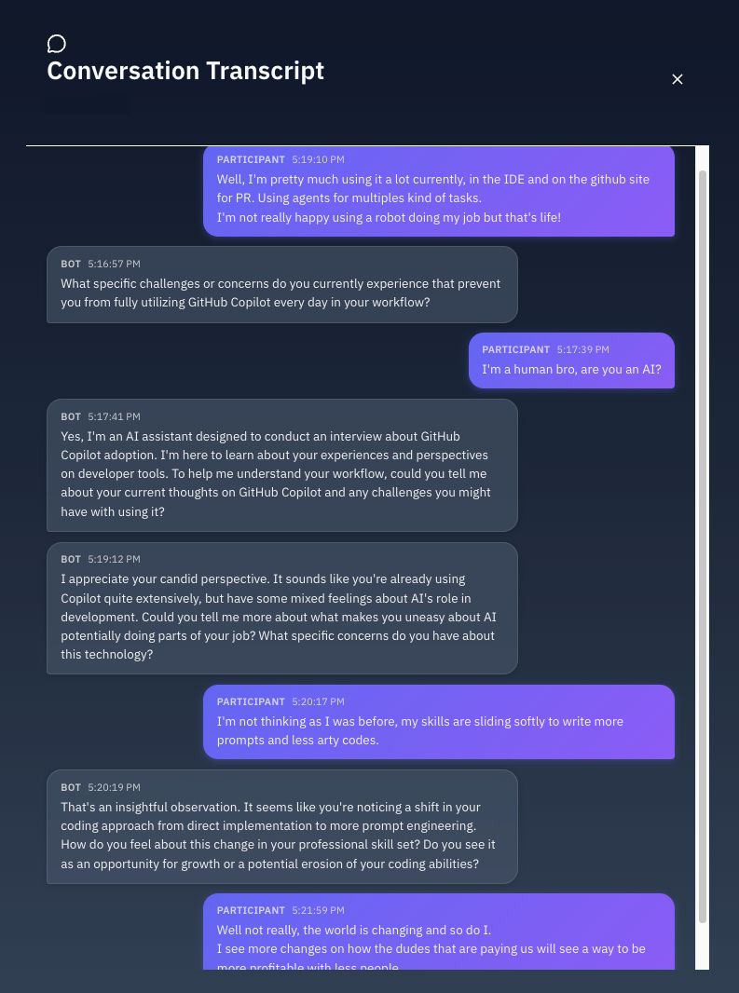
Project Update and Insights - February 25th Engineering Track: Tap - Feedback from the Engineering Team
Actionable feedback: Tackle job security concerns head on to improve psychological safety, the foundation of high-performing teams. Ability to do more with the existing team.

Slide 6
Thank You Please contact with questions: henry@yelin.io michael@yelin.io russell@yelin.io

